Slide 1
UNIT III GREEDY AND DYNAMIC PROGRAMMING
Session – 18

Slide 2
Syllabus
Introduction - Greedy: Huffman Coding - Knapsack Problem - Minimum Spanning Tree (Kruskals Algorithm). Dynamic Programming: 0/1 Knapsack Problem - Travelling Salesman Problem – Multistage Graph- Forward path and backward path.

Slide 3
Introduction
Greedy is a strategy that works well on optimization problems
Characteristics:
Greedy-choice property: A global optimum can be arrived at by selecting a local optimum.
Optimal substructure: An optimal solution to the problem contains an optimal solution to subproblems.

Slide 4
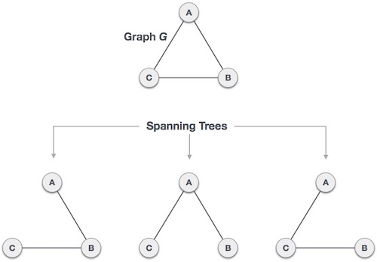
Minimum Spanning Tree
A spanning tree is a subset of Graph G, which has all the vertices covered with minimum possible number of edges.
A complete undirected graph can have maximum n^{n-2} number of spanning trees, where n is number of nodes.

Slide 5
Mathematical properties of spanning tree
Spanning tree has n-1 edges, where n is number of nodes (vertices)
A complete graph can have maximum n^{n-2} number of spanning trees.
So we can conclude here that spanning trees are subset of a connected Graph G and disconnected Graphs do not have spanning tree.

Slide 6
Application of Spanning Tree
Spanning tree is basically used to find minimum paths to connect all nodes in a graph.
Civil Network Planning
Computer Network Routing Protocol
Cluster Analysis

Slide 7
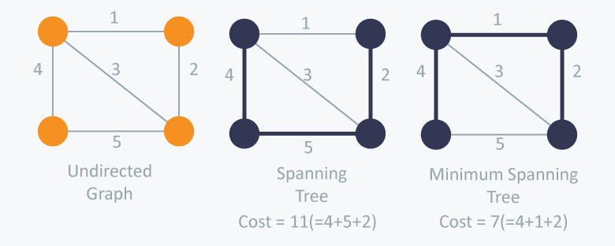
Minimum Spanning Tree (MST)
In a weighted graph, a minimum spanning tree is a spanning tree that has minimum weight that all other spanning trees of the same graph.
MST Algorithm
Kruskal’s Algorithm
Prim’s Algorithm
Both are greedy algorithms.

Slide 8
A cable company want to connect five villages to their network which currently extends to the market town of Avonford. What is the minimum length of cable needed?
Example
Brinleigh
5
Cornwell
3
4
8
6
8
Avonford
Fingley
Donster
7
5
4
2
Edan

Slide 9
We model the situation as a network, then the problem is to find the minimum connector for the network
B
5
C
3
4
8
6
8
A
F
D
7
5
4
2
E

Slide 10
Kruskal’s Algorithm
List the edges in order of size:
ED 2
AB 3
AE 4
CD 4
BC 5
EF 5
CF 6
AF 7
BF 8
CF 8
B
5
C
3
4
8
6
8
A
D
7
F
5
4
2
E

Slide 11
Kruskal’s Algorithm
Select the shortest
edge in the network
ED 2
B
5
C
3
4
8
6
8
A
D
7
F
5
4
2
E

Slide 12
Kruskal’s Algorithm
Select the next shortest
edge which does not
create a cycle
ED 2
AB 3
B
5
C
3
4
8
6
8
A
D
7
F
5
4
2
E

Slide 13
Kruskal’s Algorithm
Select the next shortest
edge which does not
create a cycle
ED 2
AB 3
CD 4 (or AE 4)
B
5
C
3
4
8
6
8
A
D
7
F
5
4
2
E

Slide 14
Kruskal’s Algorithm
Select the next shortest
edge which does not
create a cycle
ED 2
AB 3
CD 4
AE 4
B
5
C
3
4
8
6
8
A
D
7
F
5
4
2
E

Slide 15
Kruskal’s Algorithm
Select the next shortest
edge which does not
create a cycle
ED 2
AB 3
CD 4
AE 4
BC 5 – forms a cycle
EF 5
B
5
C
3
4
8
6
8
A
D
7
F
5
4
2
E

Slide 16
Kruskal’s Algorithm
All vertices have been
connected.
The solution is
ED 2
AB 3
CD 4
AE 4
EF 5
Total weight of tree: 18
B
5
C
3
4
8
6
8
A
D
7
F
5
4
2
E

Slide 17
Kruskal’s Algorithm
All vertices have been
connected.
The solution is
ED 2
AB 3
CD 4
AE 4
EF 5
Total weight of tree: 18
B
C
3
4
A
D
F
5
4
2
E

Slide 18
Kruskal Algorithm
Algorithm
Remove all loops & Parallel Edges from the given graph
Sort all the edges in non-decreasing order of their weight.
Pick the smallest edge. Check if it forms a cycle with the spanning tree formed so far. If cycle is not formed, include this edge. Else, discard it.
Repeat step#2 until there are (V-1) edges in the spanning tree.

Slide 19
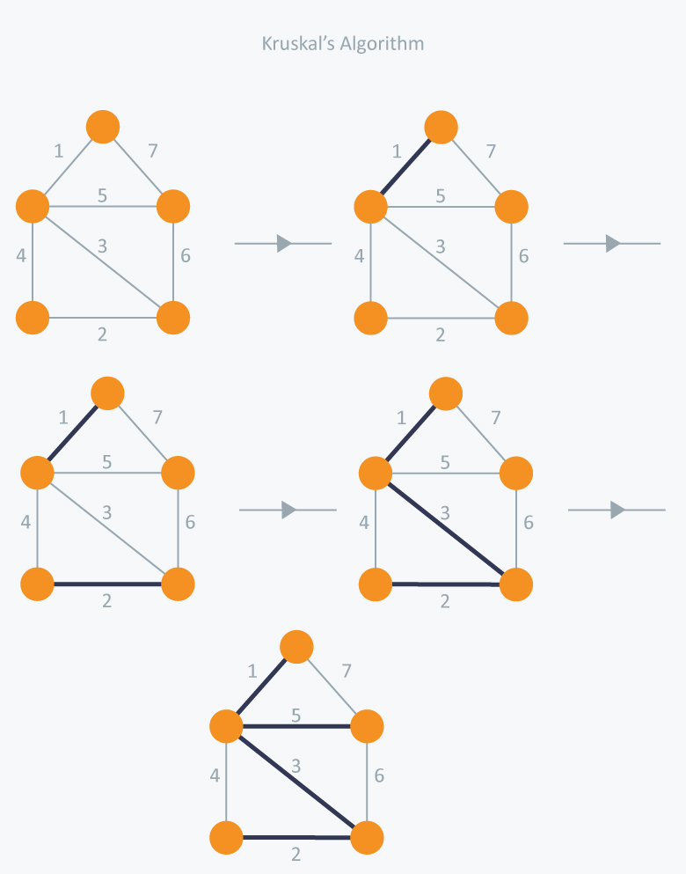
Kruskal Algorithm

Slide 20
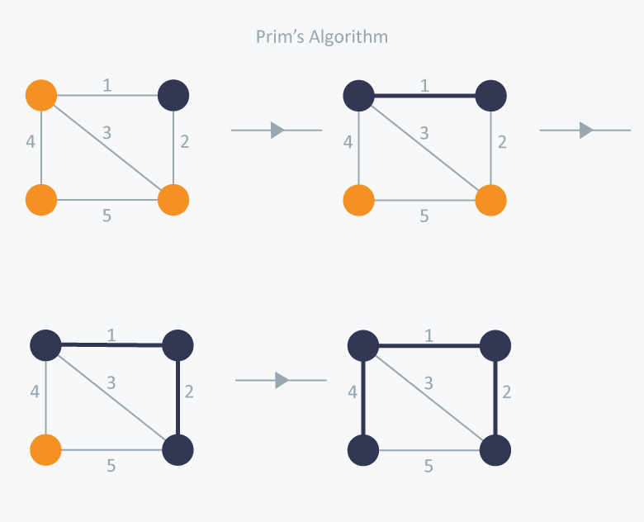
Kruskal Algorithm

Slide 21
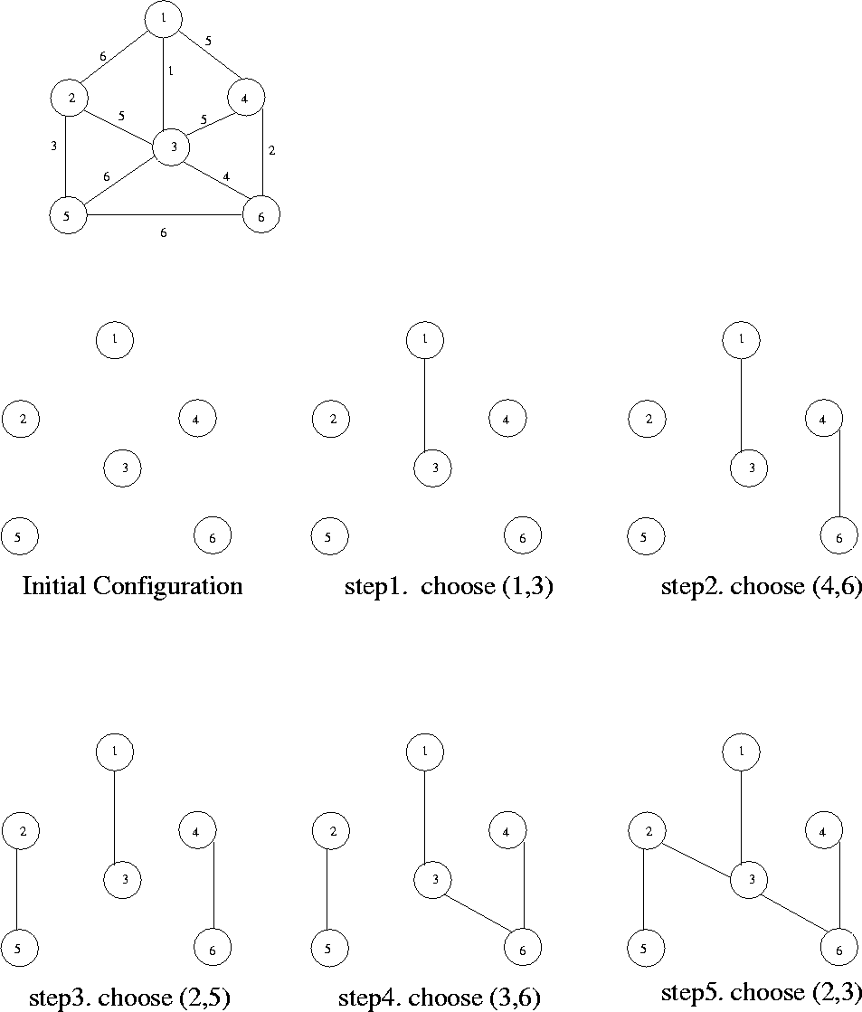
Find a MST using Kruskal Algorithm

Slide 22
Kruskal algorithm to create MST

Slide 23
Algorithm
MST-KRUSKAL(G, w)
A ← Ø
for each vertex v V[G]
do MAKE-SET(v)
sort the edges of E into nondecreasing order by weight w
for each edge (u, v) E, taken in nondecreasing order by weight
do if FIND-SET(u) ≠ FIND-SET(v)
then A ← A {(u, v)}
UNION(u, v)
return A

Slide 24
Algorithm Analysis
Time complexity
O(nlogn) where n is the number of unique characters.

Slide 25
Worksheet No. 18

